Slide 1
Home Automation
Roman Styrku
ITCS 3688 091
10/15/2018

Slide 2
What is Home Automation?
A Home Automation System (HAS) is a setup designed to simplify or automate multiple features of a home such as:
Lighting
Climate
Entertainment Systems
Appliances
Home Security Systems

Slide 3

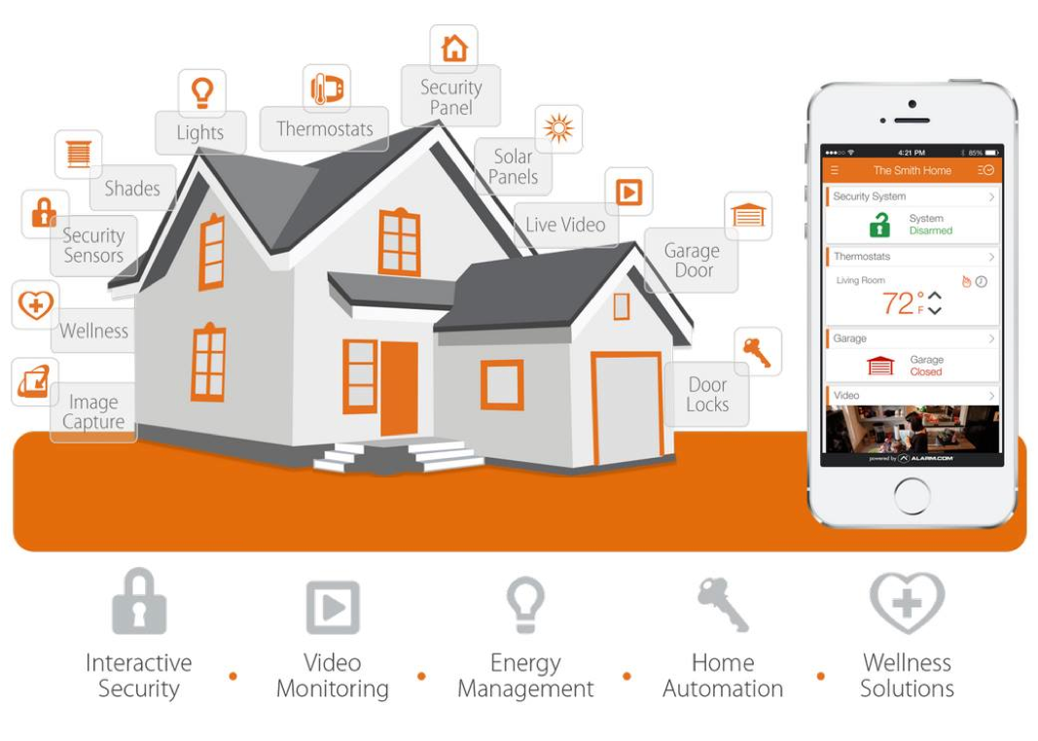
How does a HAS operate?
Wireless Automated Appliances
Central Hub
Home Wi-Fi Network
User Interface

Slide 4
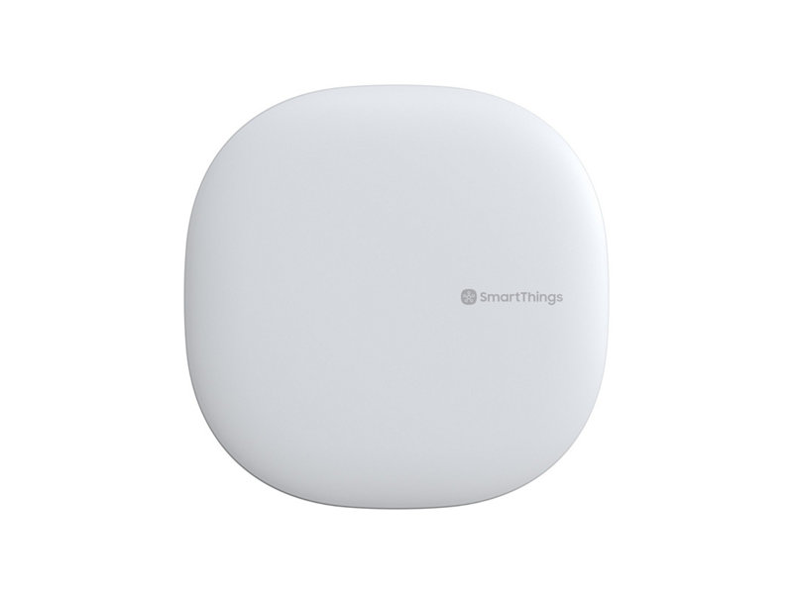
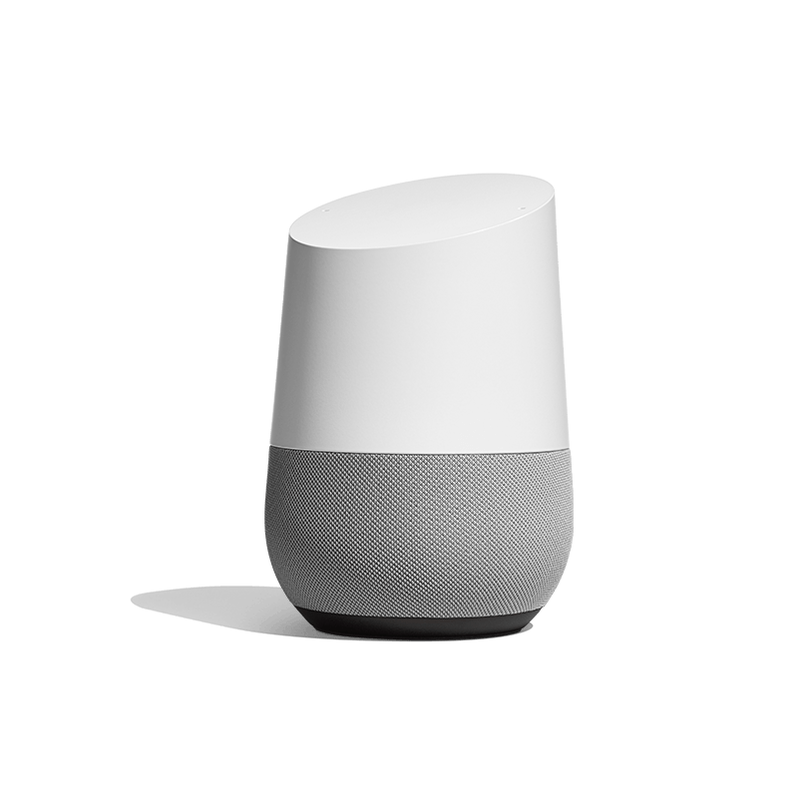
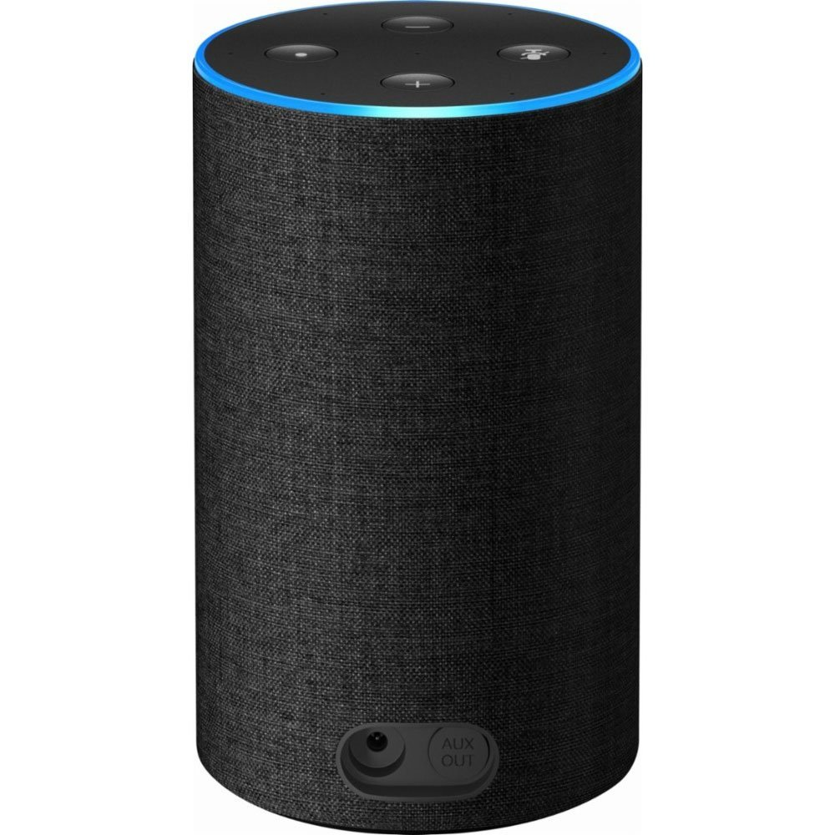
Central Hub
Hardware and Software device that controls and monitors the Wireless Automated Appliances.
Most often are designed to use Zigbee waves to connect to the appliances and Wi-Fi or Bluetooth to connect to the User Interface.
Common Examples: Samsung Smart things, Amazon Echo, Google Home.

Slide 5
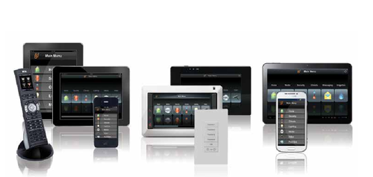
User Interface
The link between the Human and the Central Hub.
Smartphones
Tablets
Web Servers
Voice Command
Keypads and Remotes

Slide 6
Security Within Home Automation
Even though a HAS makes life easier it also can pose many security risks.
Hackers could use your central hub for surveillance if not access to your home.
Downsides of Zigbee
A defected app could give an attacker access.

Slide 7
Central Hub Surveillance and Attack
If an attack reaches the Central Hub, it can be used to monitor someone’s home.
After monitoring attackers, can use the surveillance to plan a time for a bigger attack.
With the access to the Central Hub, attackers can use the appliances to break in.
Chamberlain MyQ

Slide 8
Downsides of Zigbee
Zigbee is used because of how quick and cheap it will transfer the signal.
With the speed and cost also comes vulnerabilities.
Since Zigbee uses the 802.15 framework it also brings vulnerabilities.
With a WPAN connection Zigbee leaves easy openings once the hub is accessed.

Slide 9
Defected Apps
Today many Central Hubs can hold over 500 apps.
Attacks can be made through the apps if not carefully monitored.
Implementing an attack into the app can get an attacker access through a simple install.

Slide 10
???Question???
Is the simplicity that Home Automation brings still be worth it considering the risks? Why or Why Not?

Slide 11
What Could Be Done to Make HAS More Secure
Being on constant lookout for Design Flaws.
Requiring certain router security standards before activation and throughout updates.
App Security
Customer Awareness

Slide 12
Lookout For Design Flaws
Any small design flaw will leave an open window for a hacker to eventually attack.
A team on look out will help catch the design flaws before its too late.
Team sends out patches for any design flaws found.

Slide 13
Setting Router Standards
Even if the Central Hub has every patch applied, a faulty router can give attackers access.
The Hub should require specific security standards from the router in order to access the HAS.
Higher security standards will keep the system secure from the initial attack path.

Slide 14
App Security
Implementing some more app security could help keep hackers from attacking through apps.
A simple setup is hash comparison.
Implementing software to compare hashes before accepting random apps will help catch flaws before it’s too late.

Slide 15
Customer Awareness
Even if patches are created, and router security is checked, the primary defense of an attack is Customer Awareness.
Keeping the customer aware of the security risks.
Educating the customer on what they need from their end to ensure security.

Slide 16
???Question???
What other ways could Home Automation be made more secure while still maintaining an affordable cost.

Slide 17
???Questions???

Slide 18
Sources
https://www.consumerreports.org/cro/magazine/2014/06/run-your-home-from-your-phone/index.htm
http://improvefamily.net/gallery/perfect-how-does-home-automation-work-6/
https://link.springer.com/article/10.1007%2Fs11036-017-0960-4
https://internetofthingsagenda.techtarget.com/definition/smart-home-hub-home-automation-hub
https://lh3.googleusercontent.com/igThvoKwToXtZOfTANWbgp2ZoLnPBV2KDt9oJuaK419yIHQIo24eIcsCbgWcnfwlFjs=w1000
https://images-na.ssl-images-amazon.com/images/G/01/kindle/merch/2017/ECHO/FSCompProd/cc-ra-360x240v2._CB515844478_.png
https://s7d2.scene7.com/is/image/SamsungUS/gallery01-heroimage-GPU999SJVLGDA-072718?$product-details-jpg$
https://www.control4.com/blog/300/user-interfacesthe-human-link-to-a-home-automation-system
https://3.imimg.com/data3/XM/FT/MY-9119520/user-interfaces-500x500.png
http://theconversation.com/security-risks-in-the-age-of-smart-homes-58756

